Slide 1

CSE 229:Engineering ethics and cyber law
Presented by:
Dr. Mst. Jannatul Ferdous
Professor
Department of Computer Science and Engineering
Jatiya Kabi Kazi Nazrul Islam University, Bangladesh
Email: mjferdous_cse@jkkniu.edu.bd, mjannatul@gmail.com
3rd September, 2023

Slide 2
What is Ethics?
Derived from the Greek word “ethos”, which means “way of living”, ethics is a branch of philosophy that is concerned with human conduct, more specifically the behavior of individuals in society.
Ethics examines the rational justification for our moral judgments;
It studies what is morally right or wrong, just or unjust.

Slide 3
Senses of Ethics
Moral principles that govern a person’s behavior or the conducting of an activity.
The branch of knowledge that deals with moral principles.
Ethics is an activity of
Understanding the moral values
Resolve the moral issues
Justify the moral judgment
Ethics refers to a set of beliefs, attitudes, and habits that a person or group displays concerning morality.
Ethics is a purely factual matter about explaining beliefs and actions related to morality.
Ethics refers to being “morally correct”
People’s actions can be spoken of as “ethical” or “unethical”
Individuals can be evaluated as “ethical” or “unethical”

Slide 4
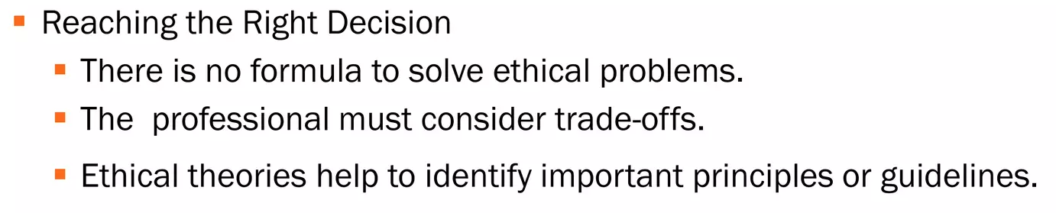
Ethical views

Slide 6
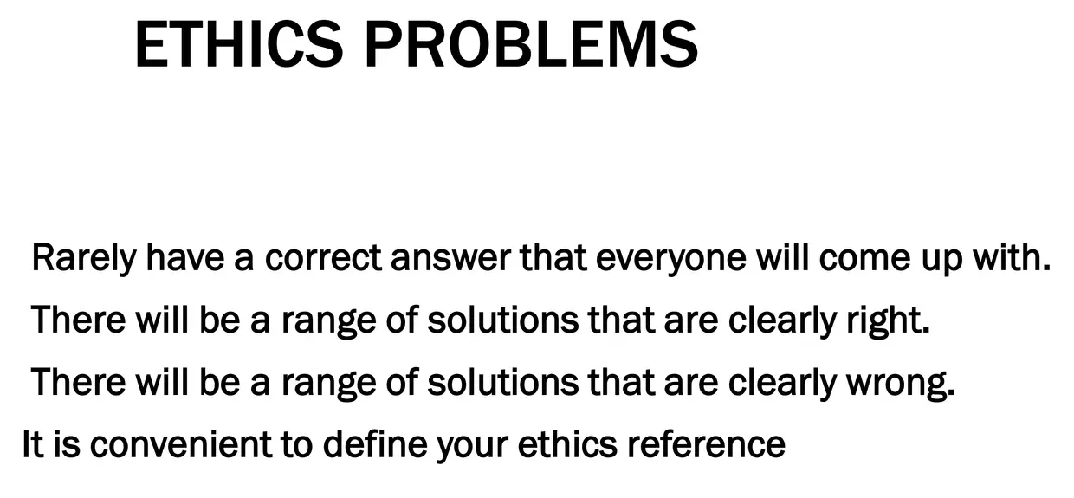

Slide 7
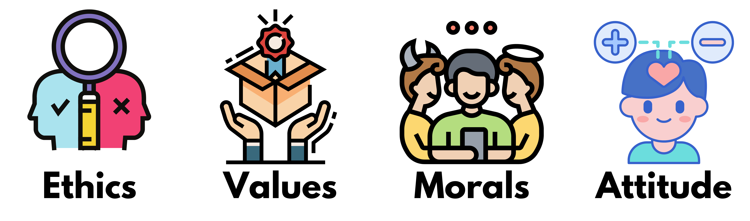
Attitudes, values, ethics, and morals are mental constructs that guide our behavior. They are responsible for influencing our choices, guiding our decision-making, and directing our behavior.

Slide 8
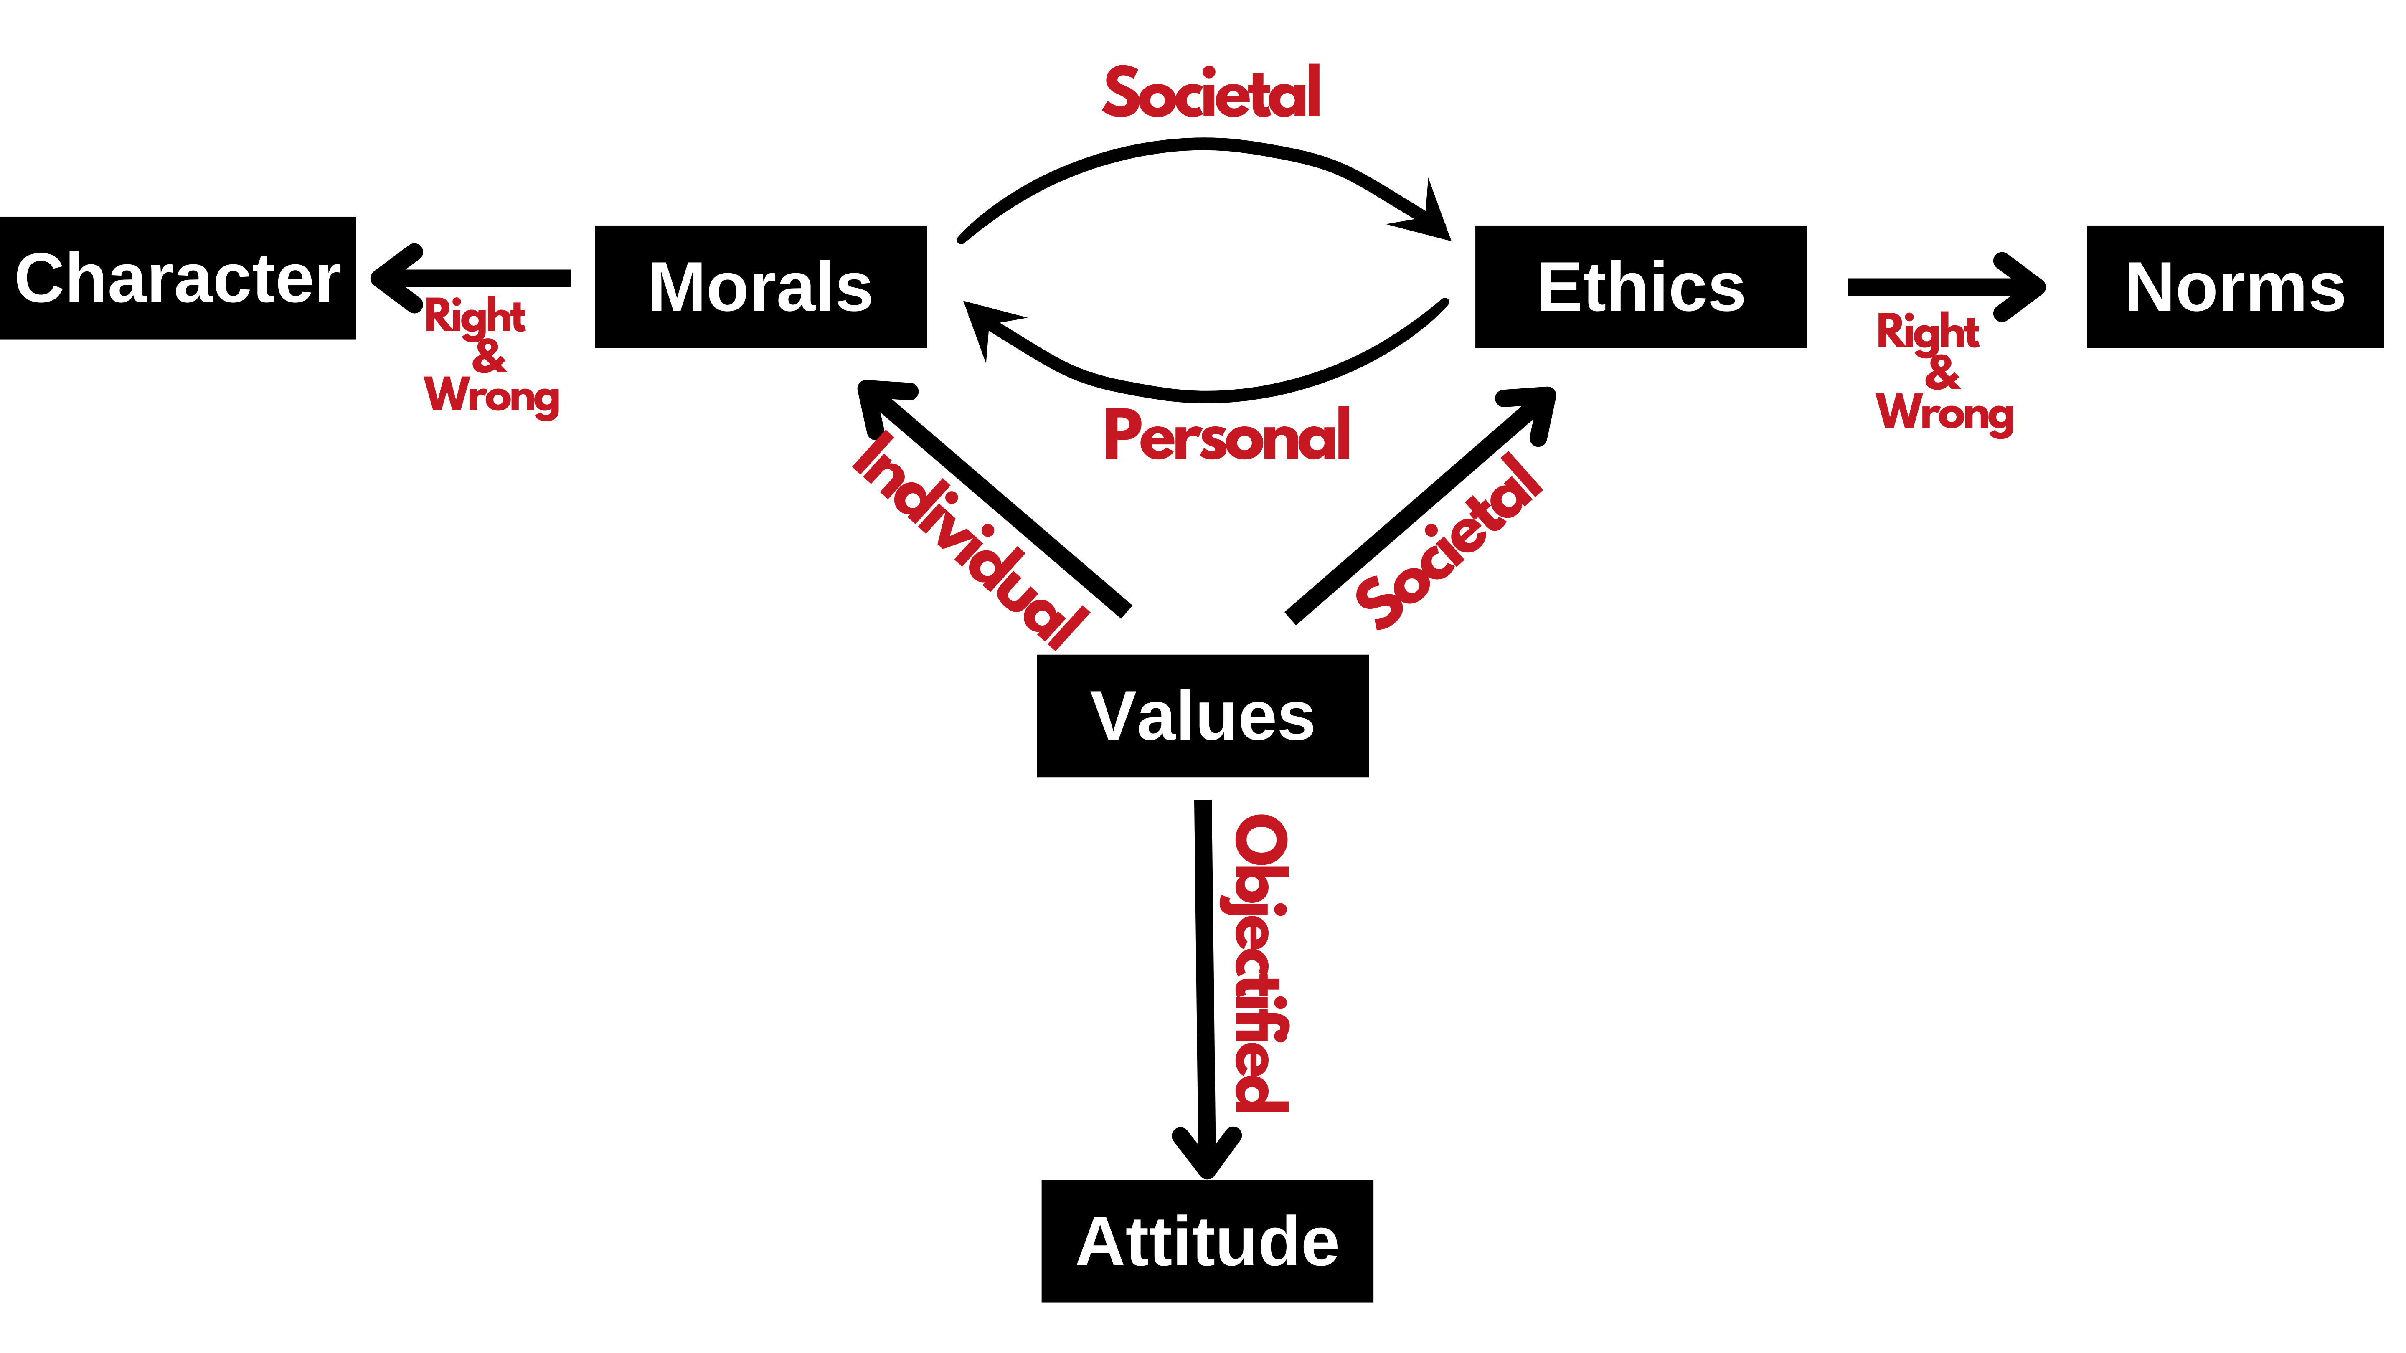
How is EVMA interrelated?

Slide 9
According to Charles Colson, “Morality describes what is, whereas Ethics describes what ought to be”. Fundamentally, Morals refer to a set of rules defining what is considered to be right or wrong and accepted without questions. These rules are typically defined by society. If someone breaks such a rule then he is typically considered to have been “bad” or “immoral.”
Values, on the other hand, provide direction in the determination of right versus wrong or good versus bad. Values are what an individual believes to have worth and importance or to be valuable. As such, morals are values defining right from wrong or good from bad.

Slide 10
Differentiate between morals and ethics
Ethics vs. Morals
Ethics and morals relate to “right” and “wrong” conduct. While they are sometimes used interchangeably, they are different: ethics refer to rules provided by an external source, e.g., codes of conduct in workplaces or principles in religions. Morals refer to an individual’s principles regarding right and wrong.

Slide 11
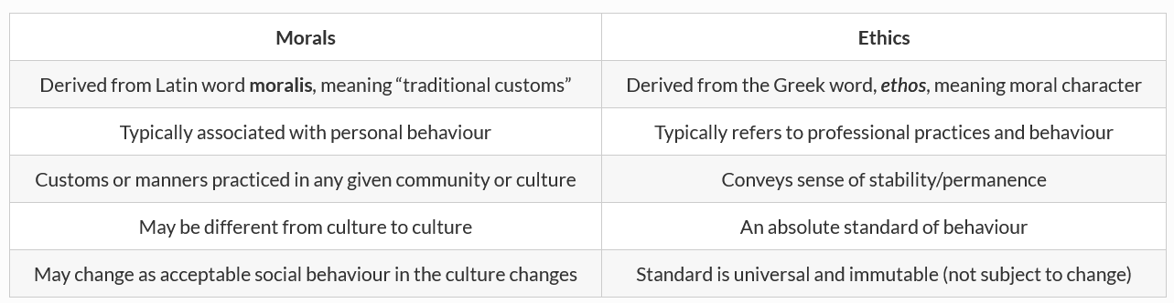
Values influence individuals' thoughts, feelings, and actions - guiding their behavior throughout life. Our values act as a compass to help us make decisions, especially when faced with difficult choices. Values can be intrinsic (meaning they come from within) or extrinsic (from external factors).
Values can be categorized as:
Intrinsic Values: These are values that are internal to an individual. They are values that the individual believes in for their own sake.
Extrinsic Values: These are values that come from external factors. They are values that an individual believes in because they think it will help them achieve something else that they value.
*Traditional customs, beliefs, or methods are ones that have existed for a long time without changing.
*Sake: the purpose for doing something

Slide 12
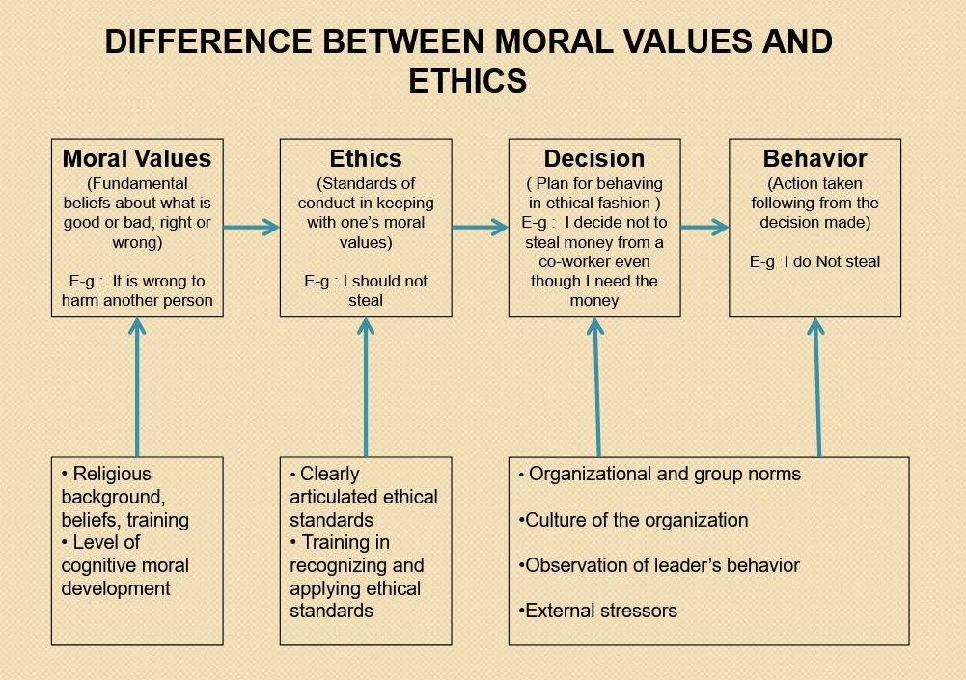
Cognition: the mental action or process of acquiring knowledge and understanding through thought, experience, and the senses.

Slide 13
5 moral values for every working professional
Honesty
Discipline
Professionalism
Respecting colleagues and their spaces
Accepting others

Slide 14
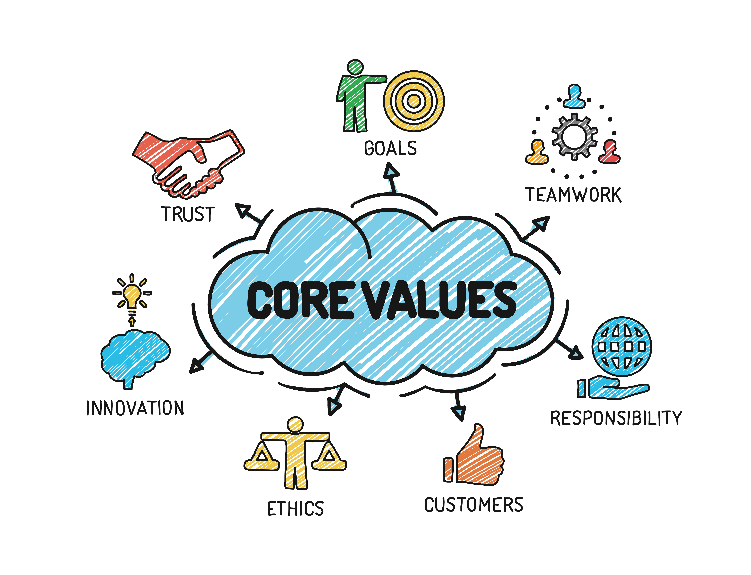
Ethics and Human Interface: Essence, determinants and consequences of Ethics in human actions; dimensions of ethics; ethics — in private and public relationships.

Slide 15
Integrity
# The quality of being honest and having strong moral principles.
What are the 5 attributes of integrity?
Dependability. Dependability means people can rely on you and that you keep promises. ...
Loyalty. Employers especially value and appreciate the loyalty of their employees. ...
Honesty. Integrity requires honesty. ...
Good judgment. ...
Respect.

Slide 16
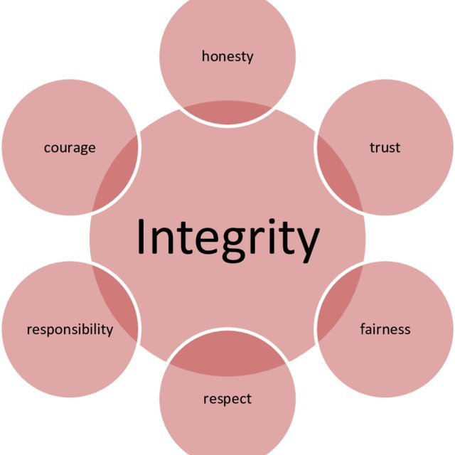
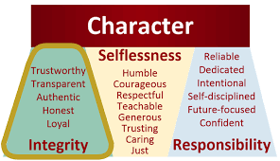

Slide 17
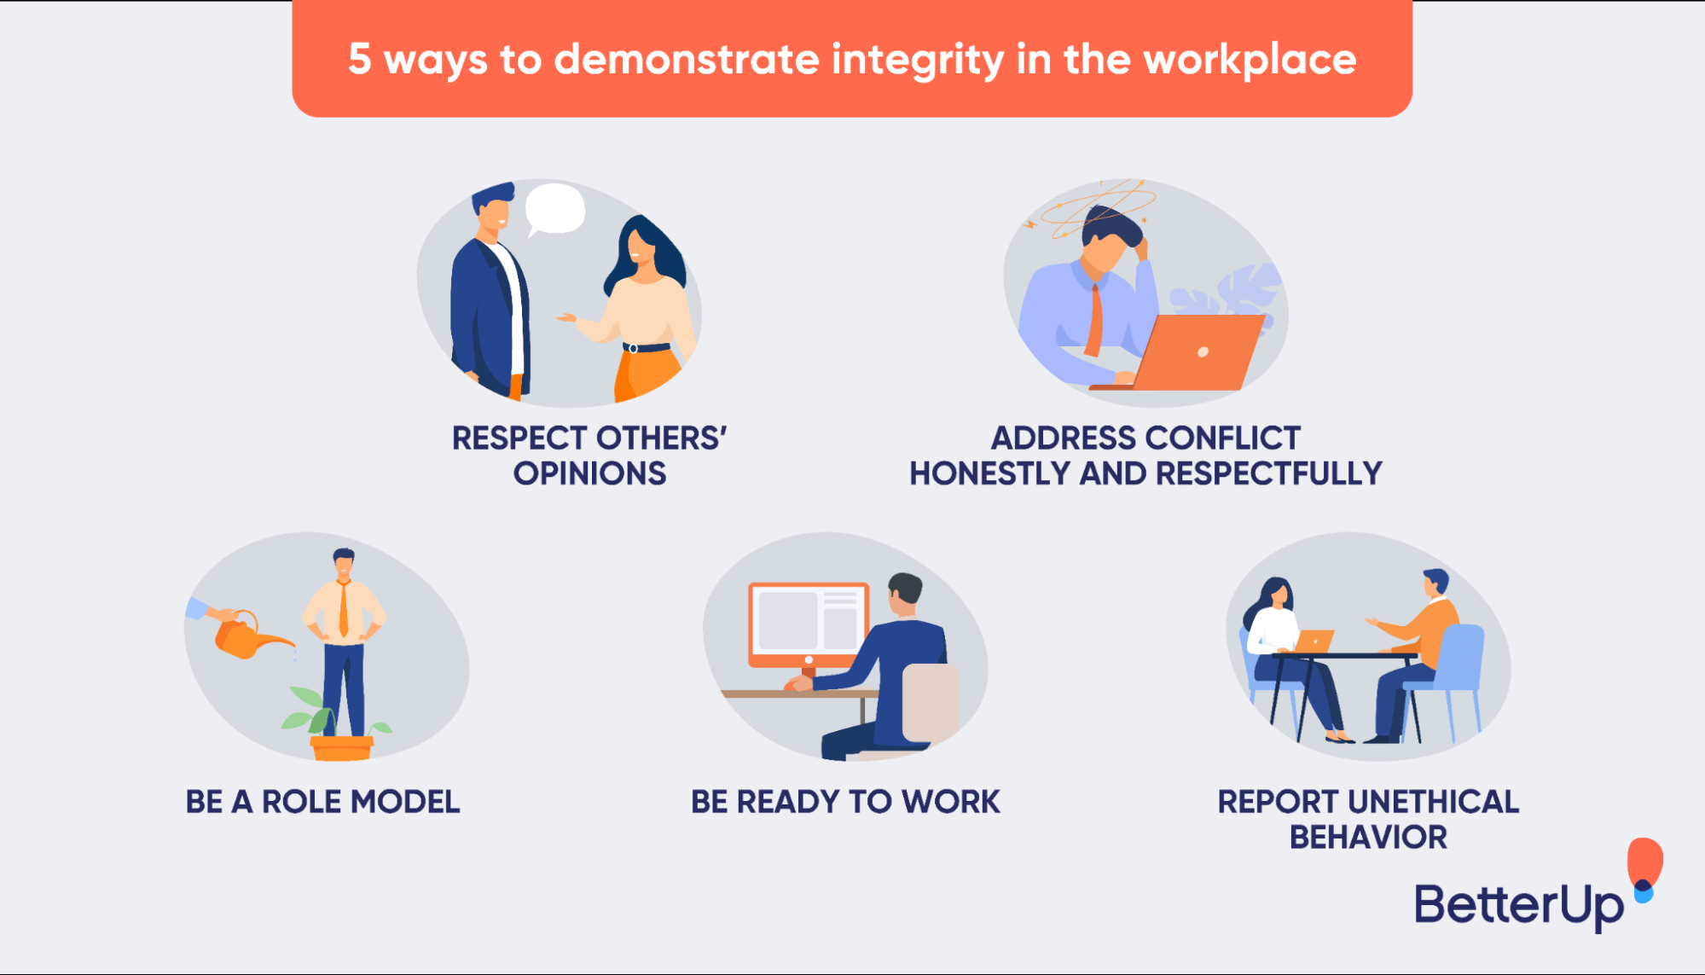
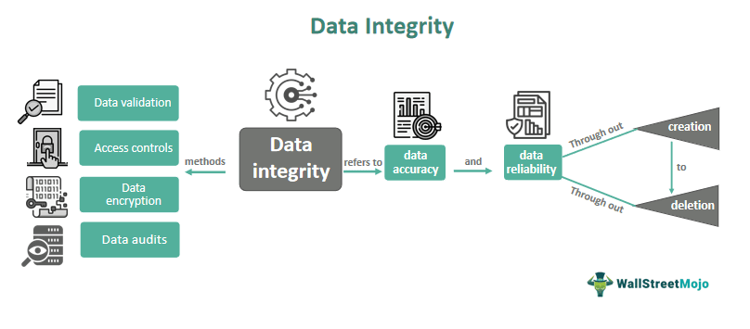

Slide 18
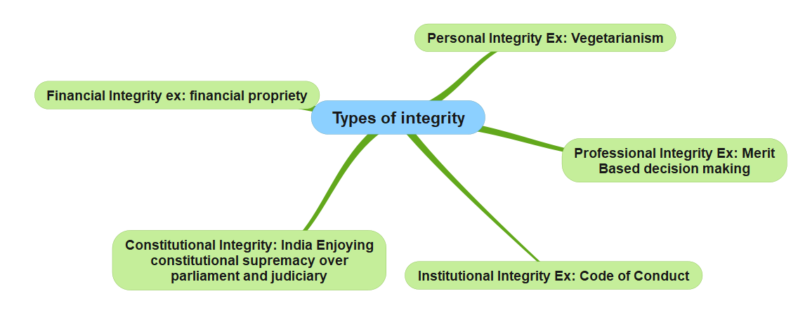

Slide 19
Types of integrity in ethics
Integrity is thus considered as one of the most important virtues and has many interpretations as:
Integrity as self-integration. ...
Integrity as identity. ...
Integrity is standing for something. ...
Integrity as purpose. ...
Personal integrity. ...
Professional integrity. ...
Institutional integrity.

Slide 20
What is work ethic?
The concept of work ethic involves a set of principles, values, and beliefs that influence how individuals behave and make decisions in their professional lives. It directly affects productivity, job satisfaction, and the overall reputation of a company.
According to a recent survey conducted by ZipDo, an astonishing 83% of employees view work ethic as a highly important trait in their coworkers. This data highlights the significance of work ethic in today’s work environment.
*https://zipdo.co/
ZipDo | Meeting Operating System
ZipDo is a meeting management and productivity software that enables teams to reduce the time they spend in meetings by following a repeatable process that ...

Slide 21
The 5 pillars of work ethics
1. Integrity
This involves being honest, ethical, and reliable in all professional dealings. It’s about doing the right thing, even when no one is watching.
How to achieve it: Be honest and ethical in all your dealings. Keep your promises and be reliable.
2. Responsibility
This involves taking ownership of one’s actions and decisions and being accountable for the outcomes.
How to achieve it: Take ownership of your actions and decisions. Be accountable for the outcomes.
3. Quality
This involves striving for excellence and taking pride in one’s work.
How to achieve it: Strive for excellence in your work. Take pride in what you do.

Slide 22
4. Discipline
This involves showing commitment, perseverance, and self-control in achieving one’s goals.
How to achieve it: Show commitment and perseverance in achieving your goals. Exercise self-control.
5. Teamwork
This involves working effectively with others to achieve common goals.
How to achieve it: Work effectively with others. Be cooperative and supportive.

Slide 23
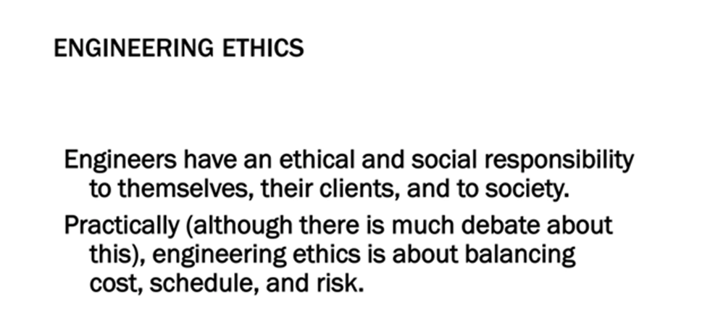
Engineering Ethics
Engineering Ethics is an activity of
Understanding the moral values that ought to guide the engineering profession
Resolve the moral issues in the profession
Justify the moral judgment concerning the profession.

Slide 24
Civic virtue
Civic virtue is morality or a standard of righteous behavior in relationship to a citizen's involvement in society. An individual may exhibit civic virtue by voting, volunteering, organizing a book group, or attending a parent-teacher association (PTA) meeting.

Slide 25
What Is a Code of Ethics?
A code of ethics is a guide of principles designed to help professionals conduct business honestly and with integrity. A code of ethics document may outline the mission and values of the business or organization, how professionals are supposed to approach problems, the ethical principles based on the organization's core values, and the standards to which the professional is held.
A code of ethics, also referred to as an "ethical code," may encompass areas such as business ethics, a code of professional practice, and an employee code of conduct.

Slide 26
What Is a Code of Ethics for Teachers?
A code of ethics for teachers defines the primary responsibilities of a teacher to their students and the role of the teacher in the student's life. Teachers are required to show impartiality, integrity, and ethical behavior in the classroom.
What Is an Example of a Code of Ethics?
An example of a code of ethics would be a business that drafts a code outlining all the ways the business should act with honesty and integrity in its day-to-day operations, from how its employees behave and interact with clients, to the types of individuals it does business with, including suppliers and advertising agencies.
What Is the Difference Between a Code of Ethics and a Code of Conduct?
A code of ethics is broader in its nature, outlining what is acceptable for the company in terms of integrity and how it operates.6 A code of conduct is more focused in nature and instructs how a business' employees should act daily and in specific situations.

Slide 27
Professional Engineering
National Institute for Engineering Ethics (NIEE)
https://www.niee.org/
Codes of Ethics
Accreditation Board For Engineering And Technology
American Institute Of Chemical Engineers
American Society Of Civil Engineers
American Society Of Mechanical Engineers
IEEE Code of Ethics
National Council of Examiners for Engineering and Surveying (NCEES) Model Rules of Professional Conduct
National Society of Professional Engineers (abbreviated as NSPE), NSPE Code of Ethics for Engineers
Software Engineering Code Of Ethics And Professional Practice

Slide 28
Architectural Engineering
Design criteria for safety over-engineering
Testing and computer-aided design tools
Conflicts with costs
Ethical engineer will NOT build a structure made unsafe by cost-saving measures
But note the unknown (resonance in failed bridges and buildings)

Slide 29
Software Engineering
Association for Computer Machinery (https://www.acm.org/ )
IEEE Computer Society ( https://www.computer.org, https://www.ieee.org/ )
IEEE Communications Society (https://www.comsoc.org/ )
Internet Society (https://www.internetsociety.org/ )
ACM RISKS Peter Neumann (http://catless.ncl.ac.uk/risks/ )

Slide 30
Observations
Observations-1
Engineering Judgment and Intuition aided by standards and tools
Example of the Challenger Space Shuttle and the O-ring problem (bad judgment and unethical management?)
Cascade failures (see Six Degrees by Duncan Watts) epidemiology, connectivity,
Observations – 2
Software theft (the original remains)
Viruses and Worms
Domain Names and Uniform Dispute Resolution Procedure (UDRP) created by the World Intellectual Property Organization at the request of the Internet Corporation for Assigned Names and Numbers

Slide 31
What Is Ethics in Research & Why Is It Important?
Research ethics govern the standards of conduct for scientific researchers. It is important to adhere to ethical principles in order to protect the dignity, rights, and welfare of research participants.
What are the 5 ethics of research?
Principles of research ethics
PRINCIPLE ONE: Minimizing the risk of harm.
PRINCIPLE TWO: Obtaining informed consent.
PRINCIPLE THREE: Protecting anonymity and confidentiality.
PRINCIPLE FOUR: Avoiding deceptive practices.
PRINCIPLE FIVE: Providing the right to withdraw.

Slide 32
The ABET is a non-governmental organization that accredits post-secondary education programs in applied and natural sciences, computing, engineering, and engineering technology.
Accreditation Board for Engineering and Technology (ABET), Inc.
Abet: encourage or assist (someone) to do something wrong, in particular to commit a crime.

Slide 33
Integrity
The quality of being honest and having strong moral principles.
The state of being whole and undivided.
Integrity is an indispensable moral virtue that includes acting with honesty, fairness, and decency.

Slide 34
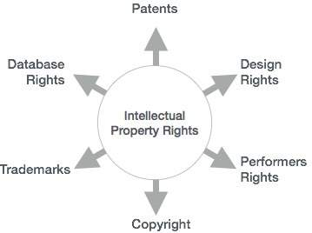
Intellectual Property Right

